Slide 1
Medicare PPO Blue FreedomRX
Medicare PPO Blue FreedomRx benefits are very similar to Medex and include $0 copays
 | MEDICAL SERVICES |  | Medicare PPO Blue FreedomRX |  | Medex
 |  |  | IN-NETWORK | OUT-OF-NETWORK
DOCTOR OFFICE VISITS | Annual Physical Exam And Medicare-Covered Preventive Care and Screening Tests |  | $0 | $0 | $0¹
 | Doctor Office Visits |  | $0 | $0 (telehealth not covered) | $0
 | Physical, Speech Therapy, Cardiac Rehab |  | $0 | $0 | $0
EMERGENCY AND URGENT CARE | Emergency Room visits |  | $0 | $0 | $0
 | Urgently Needed Care Doctor’s office or telehealth visit |  | $0 | $0 (telehealth not covered) | $0
EQUIPMENT | Prosthetics, Durable Medical Equipment |  | $0 | $0 | $0
DIAGNOSTIC TESTING | Diagnostic Testing such as Lab Tests, X-Rays, MRI’s, PET & CT Scans |  | $0 | $0 | $0
HOSPITAL | Day Surgery |  | $0 | $0 | $0
 | Inpatient Hospital Care Hospital care for illness or chronic disease for as many days as medically necessary |  | $0 | $0 | $0
¹Medicare covers Annual Wellness Visits. There may be a rider to add routine physical exam annually.
Notes:
Let’s compare some benefits on the Medicare PPO Blue FreedomRX plan to a Medex plan. As you can see, there are no out-of-pockets costs for any of these benefits whether you see an In-Network provider or you go out of the Network.

Slide 2
Medicare PPO Blue FreedomRX
ADDITIONAL BENEFITS FOR MEDICARE PPO BLUE FREEDOMRx MEMBERS!!
Annual Physical Exams | One Per Year
Hearing Exams | One Exam Every 12 Months - $0 with TruHearing Providers or $45 with Other Hearing Providers
Hearing Aids | $699 or $999 Cost per Aid – Benefits limited to TruHearing Advanced and Premium Hearing Aids
Routine Dental Exams | Exams, Cleanings and Bitewing X-Rays twice per Calendar Year. $0 In Network or $45 Out of Network
Routine Vision Exams | Routine Refractive Eye Exam Once Every 12 Months - $0 with Eye Med Providers - $45 with Other Vision Providers
Vision Supplies | Eyewear Once every 24 months up to $200 Maximum Allowance
Learn to Live | Online cognitive behavioral therapy *NEW FOR 2023*
Notes:
As a Medicare PPO Blue FreedomRX member, you have additional benefits available to you. Many of the additional benefits are not covered on a traditional Medicare Supplement plan, like Medex.
There is full coverage for annual routine physicals.
There is coverage for annual hearing exams. Save money by going to a TruHearing provider or pay a $45 copay at other providers.
There are TruHearing Hearing aids available for $699 or $999.
The Medicare PPO Blue Freedom RX plan provides coverage for Routine Dental and Routine Vision exams at no charge in-network or $45 Out-of-Network.
And members who are purchasing eyeglasses or vision supplies have up to a $200 allowance, once every 24 months.
Learn to live <>

Slide 3
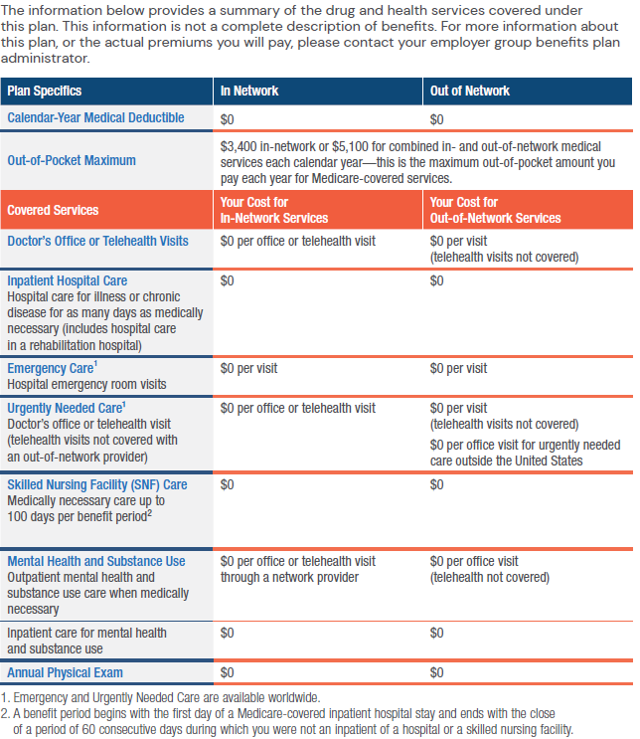
COVERED SERVICES FOR MEDICAREPPO BLUE FREEDOMRx (PPO) MEMBERS
Notes:
Out-of-Network providers need to participate with Medicare.

Slide 4
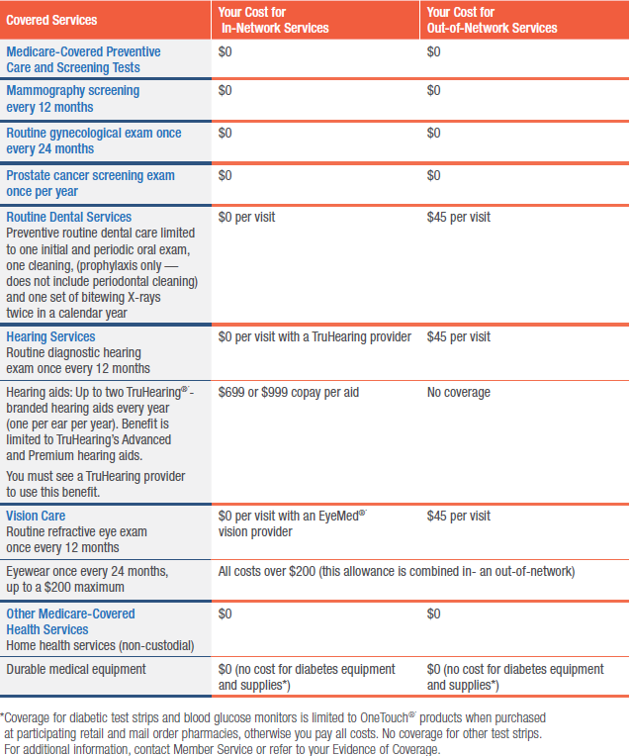
COVERED SERVICES FOR MEDICAREPPO BLUE FREEDOMRx (PPO) MEMBERS

Slide 5
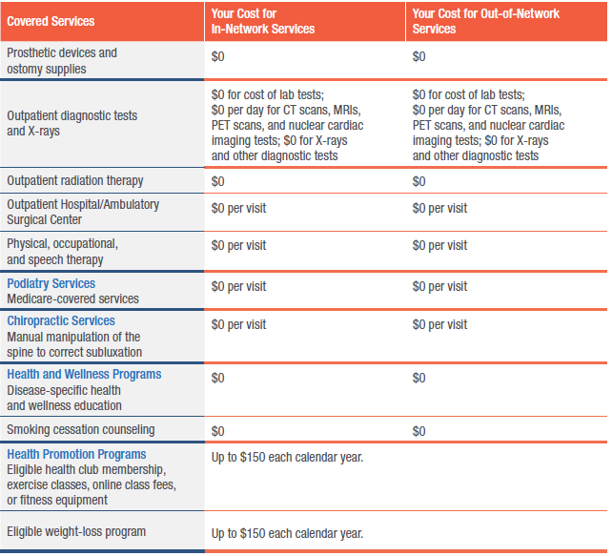
COVERED SERVICES FOR MEDICAREPPO BLUE FREEDOMRx (PPO) MEMBERS

Slide 6
COVERED SERVICES FOR MEDICAREPPO BLUE FREEDOMRx (PPO) MEMBERS
Prescription coverage for Medicare PPO Blue FreedomRx members
Prescription copay options (Retail pharmacy – up to a 30-day supply) | Prescription copay options (Mail Service pharmacy – up to a 90-day supply)
$10¹/$20²/$35^{3 DUXBURY} | $20¹/$40²/$70^{3 DUXBURY}
$5¹/$10²/$25³ | $10¹/$20²/$50³
$10¹/$25²/$50³ | $20¹/$50²/$100³
$10¹/$25²/$45³ | $20¹/$50²/$90³
Tier 1: 0 Tier 2: 20% with $50 deductible | Tier 1: 0 Tier 2: 20% with $50 deductible
Generic drugs
Preferred drugs
Non-Preferred drugs
Notes:
Save even more on prescriptions by using mail service Pay two times the copay of a 30 day retail supply for a 90 day supply delivered right to your home.

Slide 7
Fitness and weight loss benefits
www.bluecrossma.org
Get fit. Lose weight. Gain savings.
Big congrats on your healthy habits! To celebrate
All you do, we’ve put together up to $300 in
Fitness and weight loss reimbursements. Yours
for the taking, you go-getter.
Fitness BENEFIT | Weight loss BENEFIT
Membership or fitness class fees at: | Participation fees for:
A full-service health club with cardiovascular and strength-training equipment like treadmills, bikes, weight machines, & free weights. | Hospital-based programs and Non-Hospital programs (in-person or online) that combine healthy eating, exercise, & coaching sessions with certified health professionals such as nutritionists, registered dietitians, or exercise physiologists WW® in-person & online
A fitness studio with instructor-led group classes such as yoga, Pilates, Zumba®, kickboxing, indoor cycling/spinning, & other exercise programs | non-hospital programs (in-person or online) that combine healthy eating, exercise, & coaching sessions with certified health professionals such as nutritionists, registered dietitians, or exercise physiologists
Virtual offerings like online fitness memberships, subscriptions, and classes that provide cardiovascular and strength-training.
Home Fitness Equipment: like Stationary bikes (including Peloton), Weights, Kettle Bells, Bands, Treadmills
up to $150 per year
up to $150 per year
Notes:
In addition to the other great benefits Medicare PPO Blue FreedomRx provides, you can save money annually when you participate in a qualified fitness program and/or a qualified Weight-Loss program.
For the Fitness Reimbursement program, you are eligible for up to $150 for membership at either a full-service health club or fitness studio, in person or virtually or for Home Fitness Equipment.
For the Weight Loss Reimbursement program, you are eligible each calendar year for up to $150 for any weight loss program that combines healthy eating, exercise, & coaching sessions with certified health professionals.
This is a standard benefit on Medicare PPO Blue FreedomRx that is included with no additional rider required, but both benefits are available riders on Medex.

Slide 8
Learn to live
Launched in 2023
Learn to Live (L2L) provides self-paced Cognitive Behavioral Therapy (CBT) programs and personalized coaching you can use whenever and wherever you need it.
Comprehensive clinical assessments
Personalized, clinician coaching
Self-directed programs (English and Spanish):
Depression
Stress, Anxiety & Worry
Social Anxiety
Insomnia
Substance Use
Panic
Resilience
Members can access
Learn to Live by signing
into their MyBlue account: https://medicare.bluecrossma.com/
Notes:
Learn to Live provides self-paced Cognitive Behavioral Therapy programs and personalized coaching members can use wherever and whenever they need it. The therapists are masters level in social work, psychology or counseling. Learn to live also includes on-demand webinars that address a variety of topics including resilience, stress and time management, sleep, perfectionism, substance abuse and panic.

