Slide 1
Welcome to your presentation on the following products:
Vision Insurance Dental Insurance
Group Life Permanent Life
Cancer Expense Critical Illness
Accident Insurance Pet Insurance

Slide 2
Vision Insurance

Slide 3
What is Vision Insurance?
1
Medical Plan
2
Discount Plan
v
3

Slide 4
Definitions
1
Co-Pay = Member share
2
Allowance = Max the carrier will pay
v
3
Discounts = Additional percent off

Slide 5
Understanding Vision Insurance
12/12/12
12/12/12 = how often you can get an eye exam
12/12/12 = how often you can get contacts OR glass lenses
12/12/12 = how often you can get new frames
Duxbury Plan:
12/12/12
Covered Standard Progressive Lenses
Increased benefit for Premium progressive lenses
¹Consumer Healthcare Perceptions study, commissioned by Ipsos Marketing nd EyeMed, 2018.
Notes:
Just like employees expect a choice of independent v retail, and a choice among retailers, they also expect a choice of online options. A single online solution isn’t enough.
NOTE TO PRESENTER:
Could point out differences compared to competitors –
VSP has one solution only (eyeConic)
Davis does not offer the ability to use in-network benefits online
Superior only offers the ability to purchase contacts

Slide 6
Your benefits at-a-glance
Comprehensive eye exam every 12 months, covered with $10 copay
$130 frame allowance every 12 months
$25 standard lens copay, including standard progressive lenses
$130 contact lens allowance, with coverage for fit and follow-up every 12 months
Notes:
NOTES TO PRESENTER:
When going through the proposed benefits, make a comparison statement to what they have today. Either state that it is comparable to their current benefit, or call-out where it may be richer.
Should also talk through how they can get frames and contact lenses in the same benefit year. (Can point to slide to say you get this (lenses) or this (contacts). If you pick this, you get this and this. If you pick this, you get this and this plus this).
Call out that you’ll walk them through each component and enhancements we can offer to make their benefits better

Slide 7
Additional discounts for added member savings
40% off additional pairs of glasses
40% off hearing exams and discounted, set pricing on hearing aids
20% off any remaining frame balance
20% off any non-covered item
15% off LASIK
15% off any balance over the conventional contact lens allowance
99% of clients agree that our benefits result in low out-of-pocket costs for members*
*Discounts are in-network only. May not be available on all plans. Confirm if your provides this option. *EyeMed Client Satisfaction Survey conducted by Walker, 2018.

Slide 8
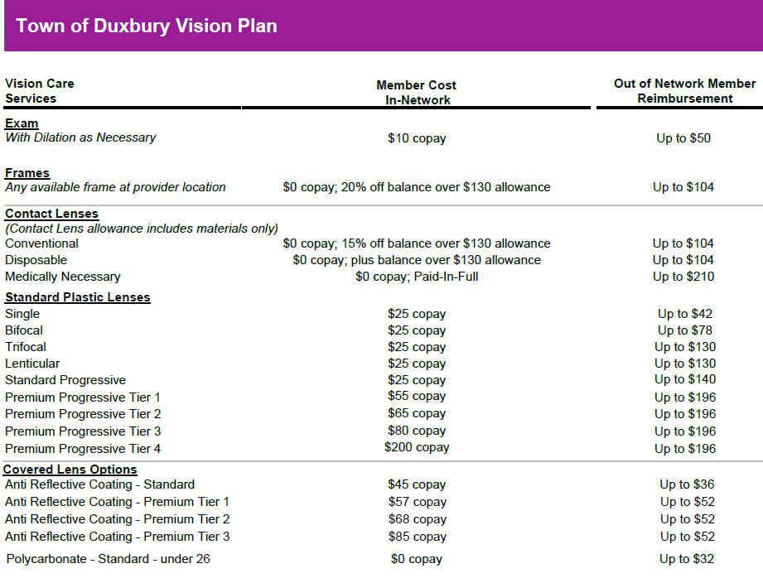
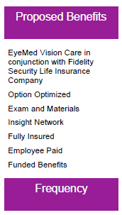
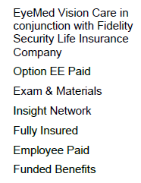
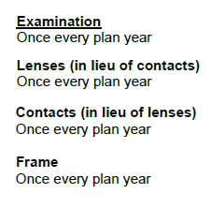
All plans are based on a 48-month contract term and 48-month rate guarantee Monthly Rate is subject to adjustment even during a rate guarantee period in the event of any of the following events: changes in benefits, employee contributions, the number of eligible employees, or the imposition of any new taxes, fees or assessments by Federal or State regulatory agencies
EyeMed Vision Care reserves the right to make changes to the products available on each tier. All providers are not required to carry all brands on all tiers. For current listing of brands by tier, visit http://www.discovereyemed.com
Plan Details Quote for group sitused in the State of MA and will be valid until the 7/1/2022 implementation date. Date Quoted 5/10/2022. Benefit allowances provide no remaining balance for future use within the same benefit frequency. Rates are valid only when the quoted plan is the sole stand-alone vision plan offered by the group. Percentage discounts are not part of the insurance benefit. Insured benefits are underwritten by Fidelity Security Life Insurance Company. Policy Number VC-19; Policy Form No. M-9083 Plan Exclusions No benefits will be paid for services or materials connected with or changes arising from:
-orthoptic or vision training, subnormal vision aids and any associated supplemental testing; Aniseikonic lenses;
-medical and/or surgical treatment of the eye, eyes or supporting structures;
-any Vision Examination, or any corrective eyewear required by a Policyholder as a condition of employment; safety eyewear;
-services provided as a result of any Workers' Compensation law, or similar legislation, or required by any governmental agency or program whether federal, state or subdivisions thereof;
-plano (non-prescription) lenses;
-non-prescription sunglasses;
-two pair of glasses in lieu of bifocals;
-services or materials provided by any other group benefit plan providing vision care;
-services rendered after the date an Insured Person ceases to be covered under the Policy, except when Vision Materials ordered before coverage ended are delivered, and services rendered to the Insured Person are within 31 days from the date of such order; or
-lost or broken lenses, frames, glasses, or contact lenses will not be replaced except in the next Benefit Frequency when Vision Materials would next become available.

Slide 9
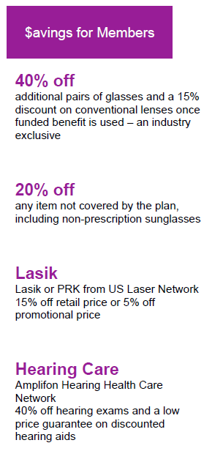
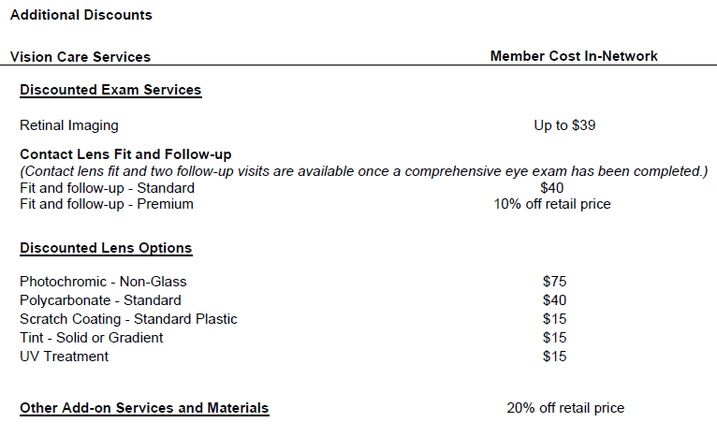
Discount Details Member receives a 20% discount on items not covered by the plan at EyeMed In-Network locations. Discount does not apply to EyeMed Provider's professional services, or contact lenses. Plan discounts cannot be combined with any other discounts or promotional offers. In certain states members may be required to pay the full retail rate and not the negotiated discount rate with certain participating providers. Please see EyeMed’s online provider locator to determine which participating providers have agreed to the discounted rate. Discounts on vision materials may not be applicable to certain manufacturers' products EyeMed Vision Care reserves the right to make changes to the products on each tier and the member out-of-pocket costs. Fixed pricing is reflective of brands at the listed product level. All providers are not required to carry all brands at all levels. Service and amounts listed above are subject to change at any time

Slide 10
Dental Insurance

Slide 11
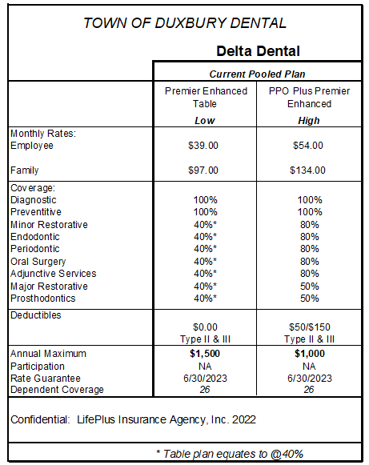

Slide 12
Group Life

Slide 14
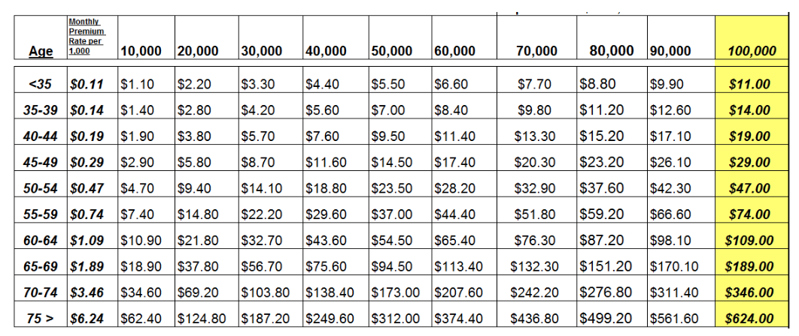

Slide 15
Permanent Life

Slide 16
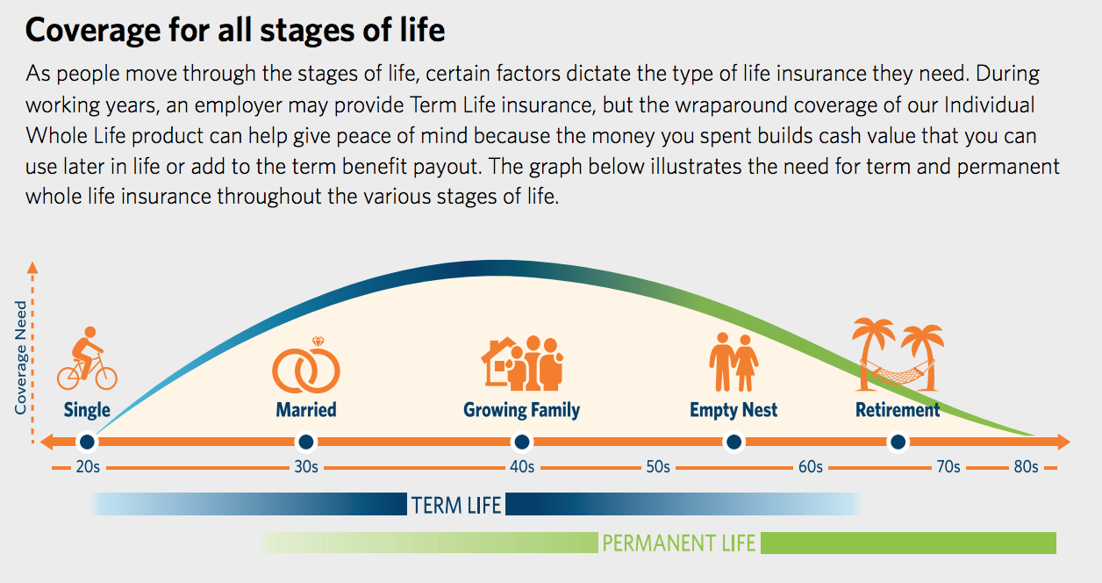

Slide 17
Cancer Expense

Slide 18
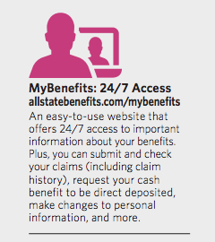
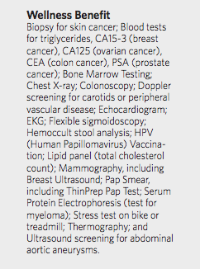
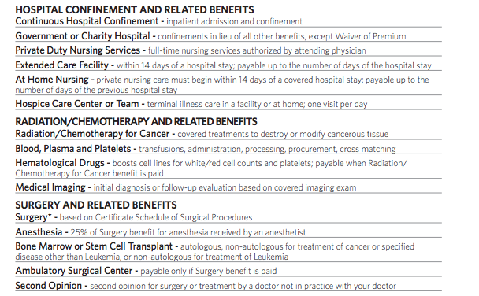
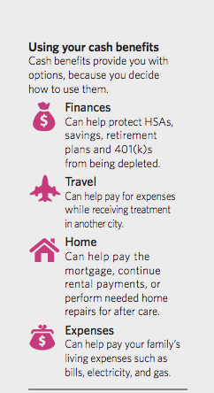
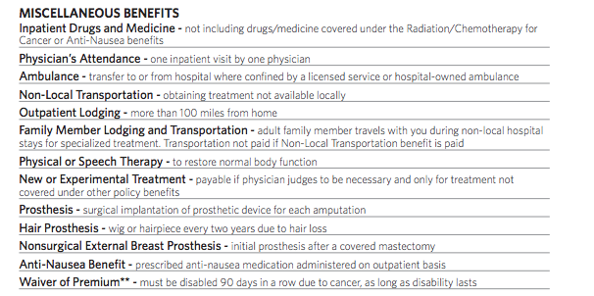

Slide 19
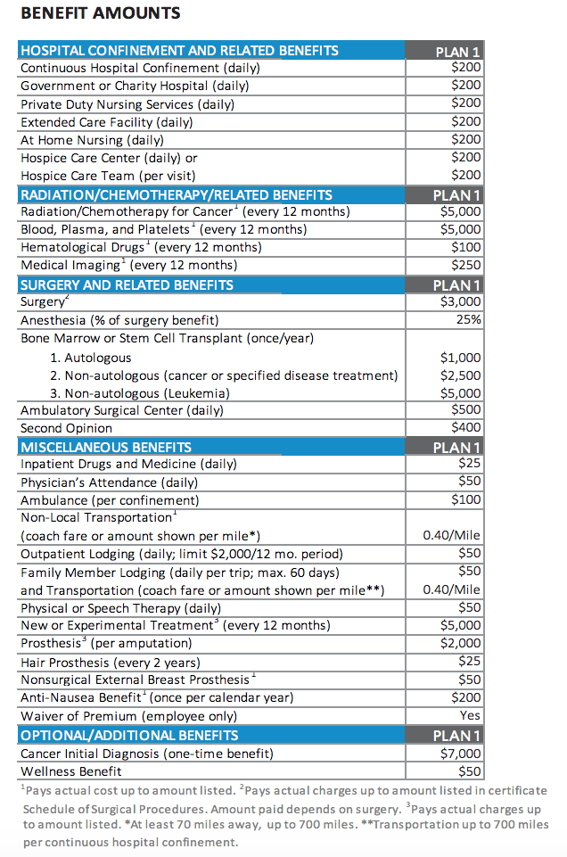
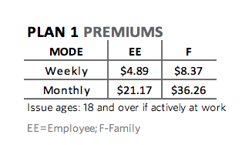

Slide 20
Critical Illness

Slide 21
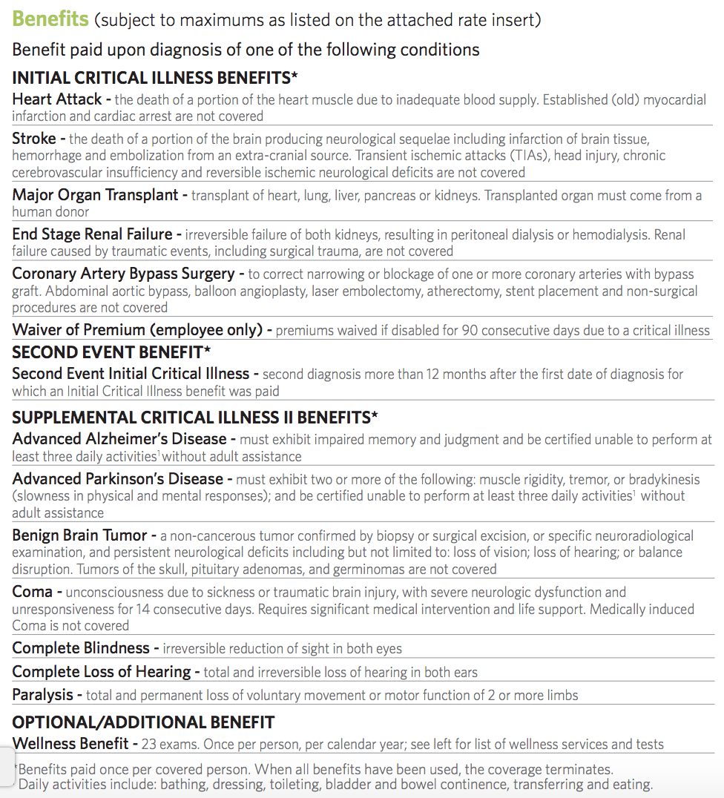
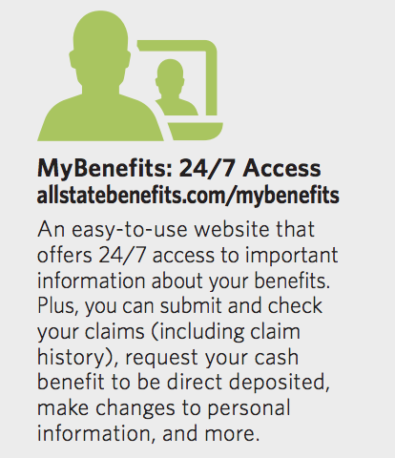
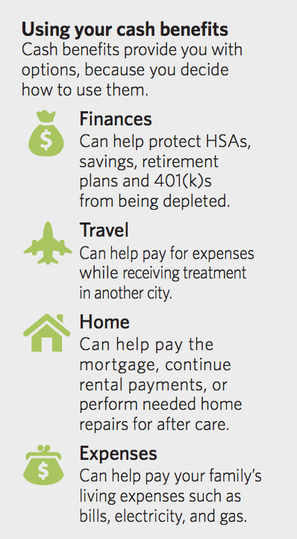
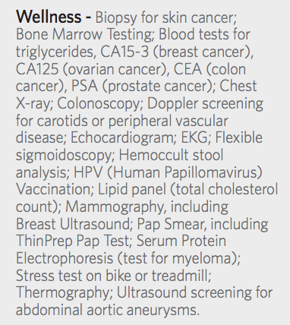

Slide 22
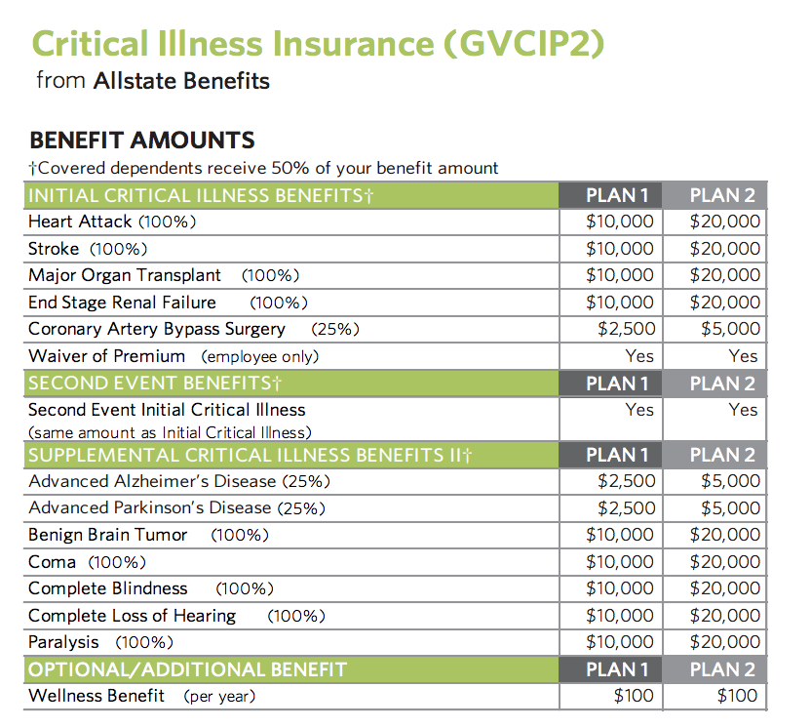

Slide 23
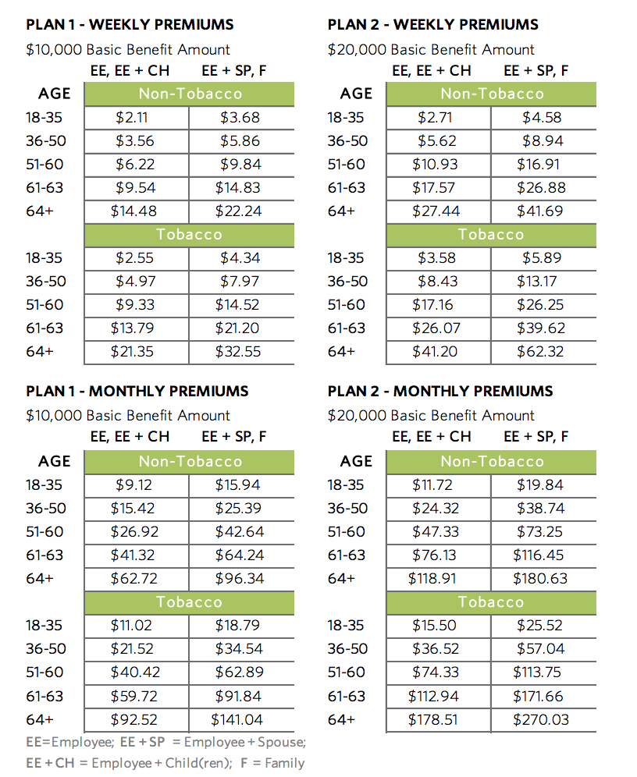

Slide 24
Accident Insurance

Slide 25
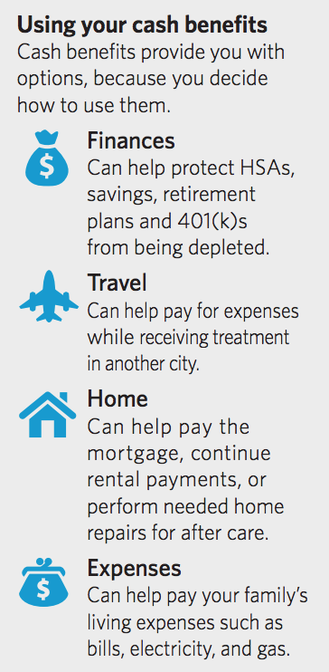
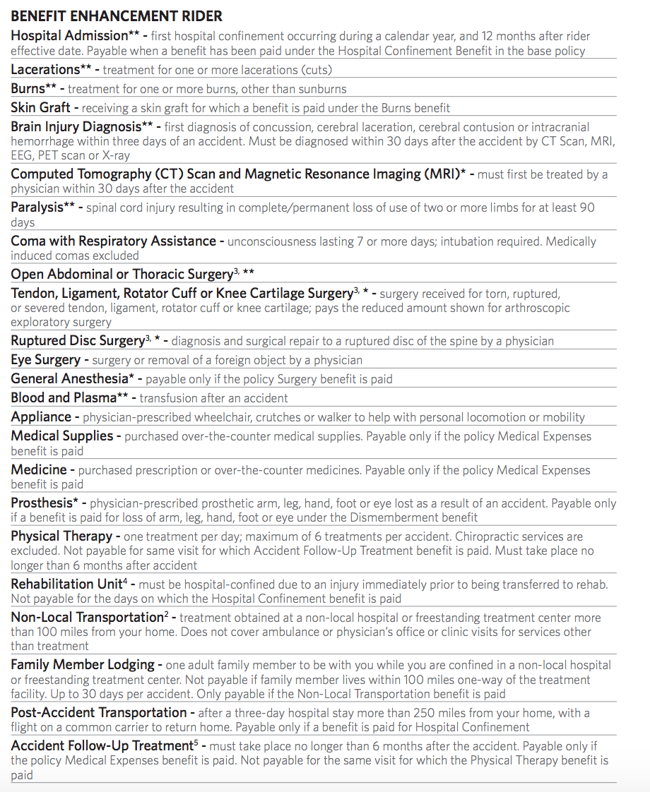
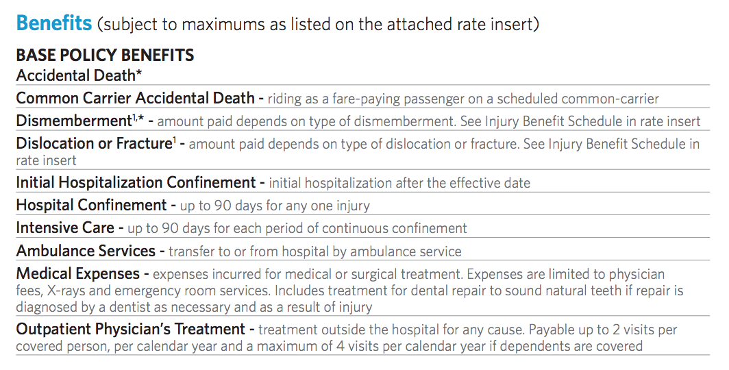
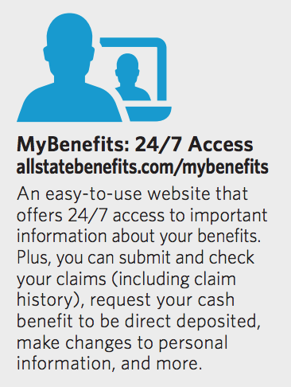
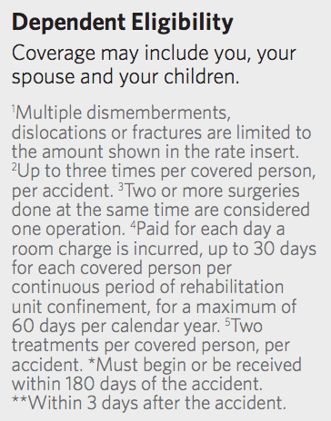

Slide 26
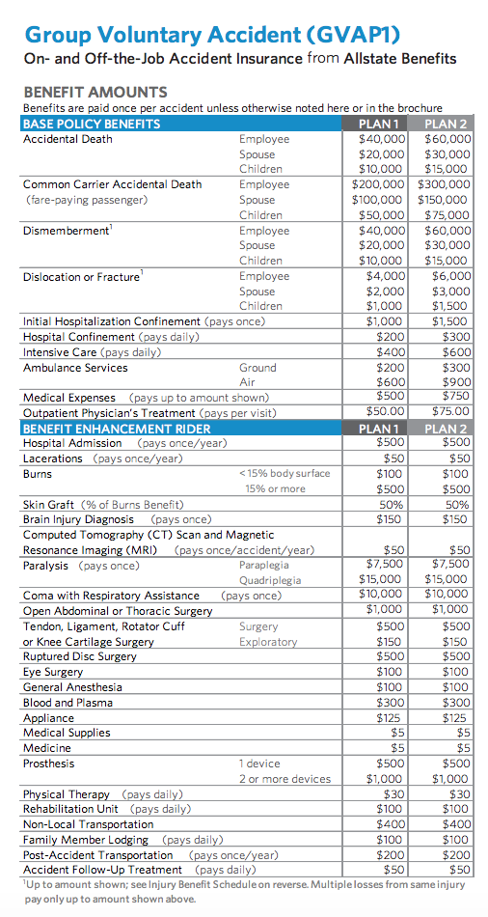
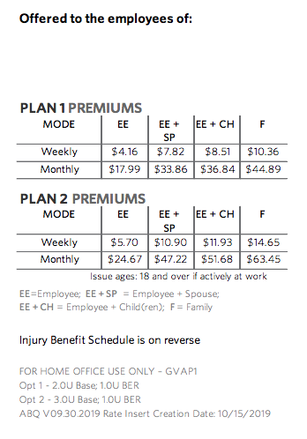

Slide 27
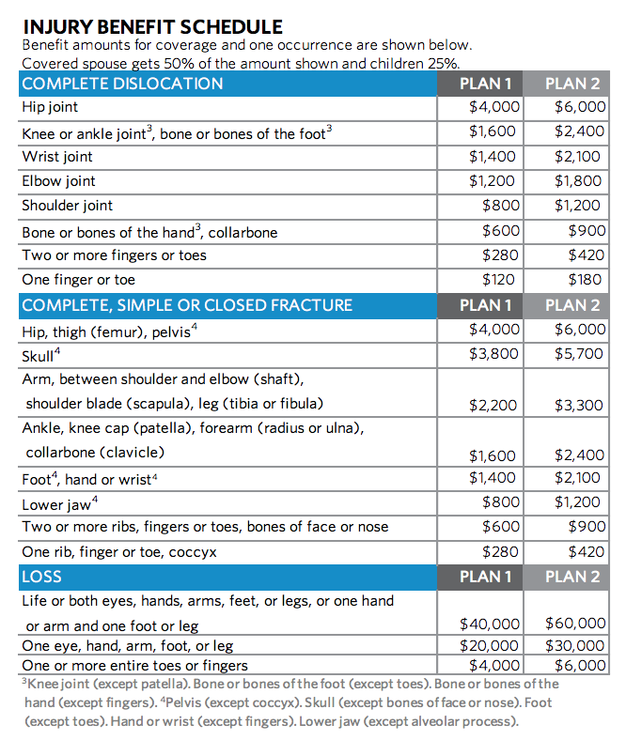

Slide 28
Pet Insurance

Slide 29
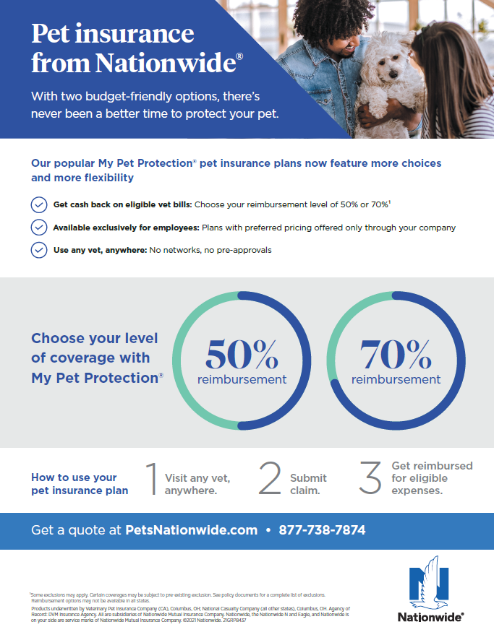

Slide 30
FINALLY, LET’S JUST TALK
Any questions?
Please feel free to call or email an Agent at any time
Jim Flynn is available at (781) 789-8859 or Jim@lpins.com
Roger Goodson is available at (781) 987-4020 or Roger@lpins.com

